Slide 1


🚀 GenAI Chatbot & DocuMind AI: AI-Powered Assistance
Welcome! This presentation will showcase a multi-functional AI assistant. It's built using Streamlit and LangChain. Two key features: GenAI Chatbot and DocuMind AI. Let's dive in!
by Shahnawaz Aadil

Slide 2
🎯 Project Overview: AI-Powered Assistance
GenAI Chatbot
DocuMind AI
An AI coding assistant for debugging and pair programming.
An intelligent document analysis and Q&A system.
Built with Streamlit & LangChain. Uses Ollama LLM (DeepSeek-R1) for processing.

Slide 3
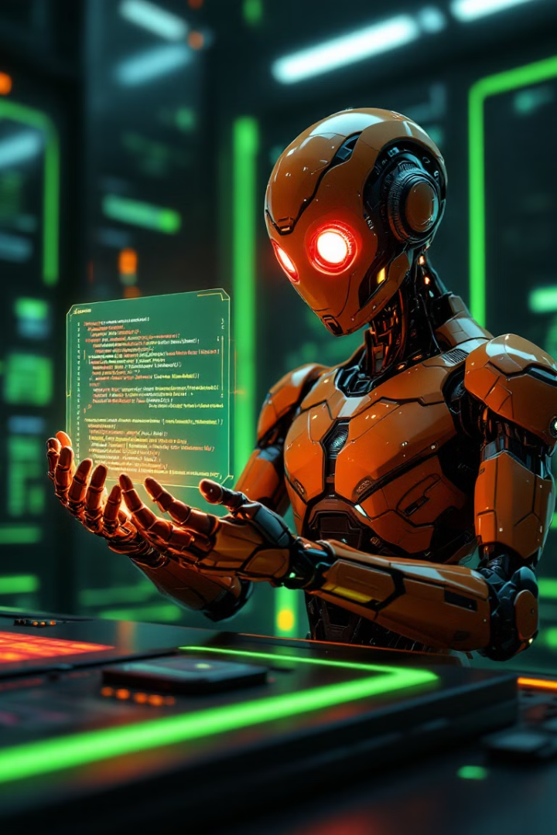
1️⃣ GenAI Chatbot: Your AI Coding Assistant
1
Conversational AI
2
Debugging
For coding-related help.
AI suggests print statements.
3
Interactive UI
Responsive with live typing effects.
System prompt tuning ensures expert, concise solutions.

Slide 4




2️⃣ DocuMind AI: Your AI Research Assistant
Uploads and processes PDF research documents.
Splits content into chunks for efficient search.
AI-powered Q&A based on content.
Vector-based document retrieval finds relevant sections.

Slide 5

🛠 Technologies & Frameworks
Technology
Purpose
Streamlit
Web app framework
LangChain
AI framework
Ollama LLM
Language model
PDFPlumber extracts text. Vector Embeddings enable semantic search.

Slide 6




🎨 UI & User Experience Enhancements
Custom CSS
Modern dark-themed UI.
Dynamic chat
Smooth AI conversation.
Typing effect
Real-time AI responses.
Expander sections provide detailed project information.

Slide 7

📌 Future Enhancements
1
Add Memory
Store past conversations.
2
Format Support
Word, PPT, etc.
3
Fine-tuned LLM
Domain-specific responses.
4
Web App
Broader accessibility.
These improvements will enhance user experience and functionality.

Slide 8

🎯 Conclusion & Next Steps
1
Powerful System
2
Enhances Productivity
AI-powered Chatbot & Document Analysis.
In coding and research.
3
Intelligent Responses
Combines LLMs, vector search, and NLP.
Ready to scale and improve with future AI advancements. Any Questions? 🚀

